Slide 1
Gene Response Prediction Model
Alex Hassett

Slide 2
Data
CCLE/TCGA Gene Expression Dataset (15363 cell responses, 104 samples)
PRISM Drug Dataset (4686 drugs, 104 samples)
Validation Split:
80% training
20% validation

Slide 3
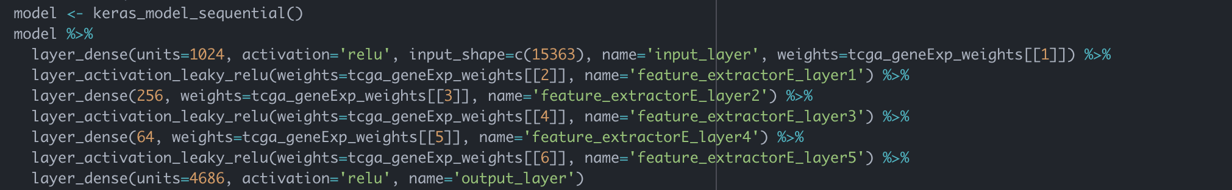
Model
Sequential Keras Model trained in R
Pre-trained weights from TCGA Variational Autoencoder Model
Froze first two feature extractor layers (Transfer-learning)
Fine-tuning learning rate: 0.001

Slide 4
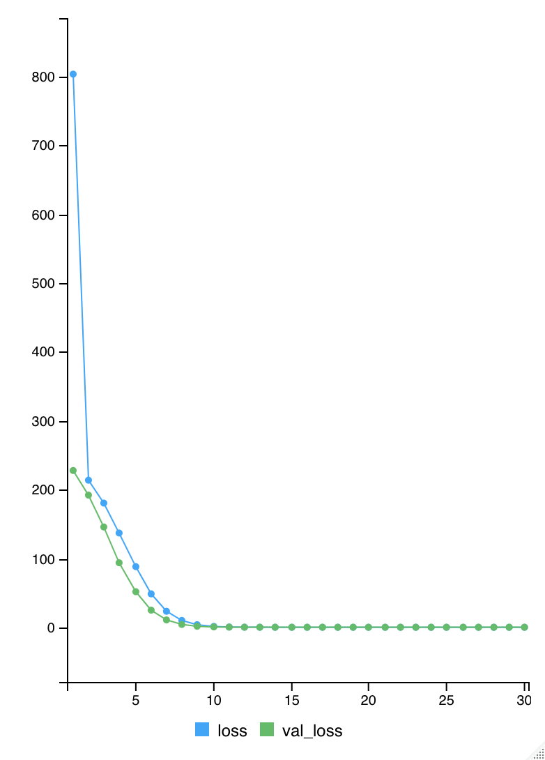
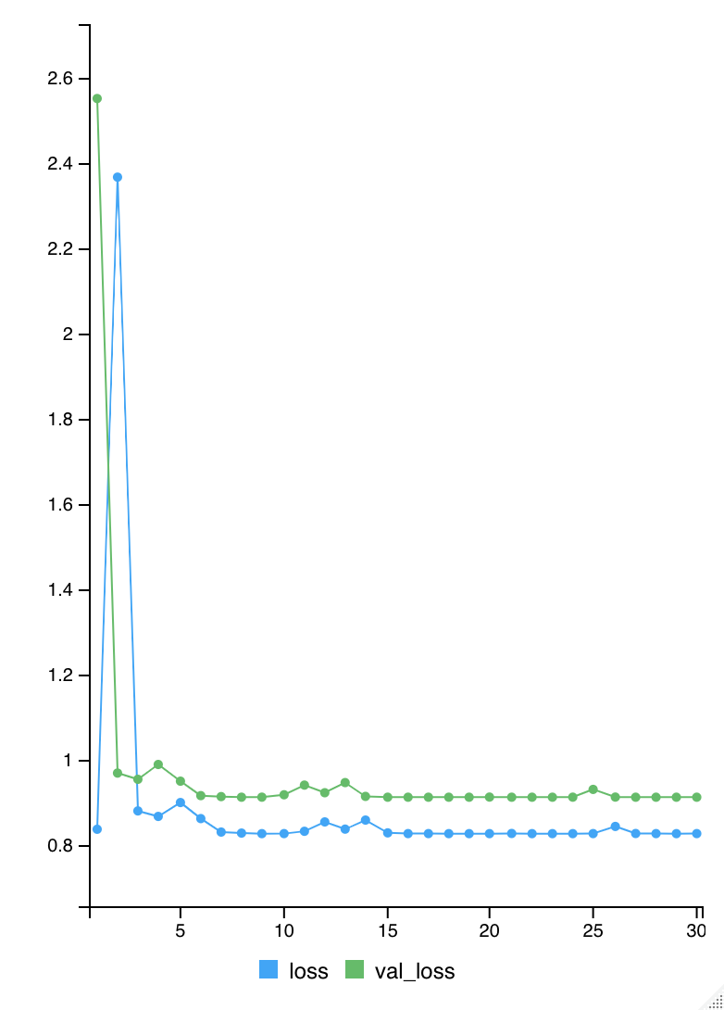
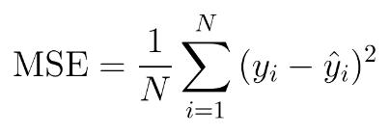
Loss
Validation Loss:
0.9119

